Slide 1
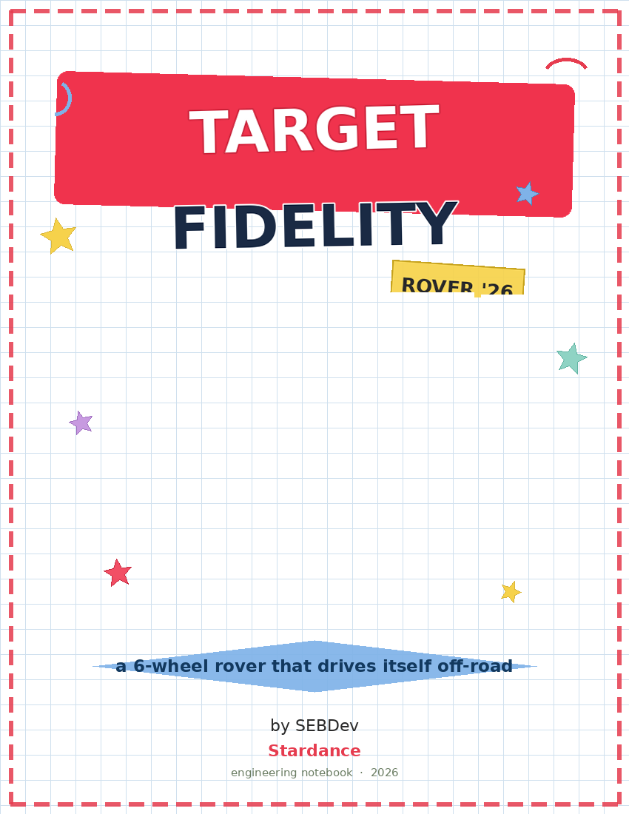

Slide 2
Table of Contents
Page | Entry | Date
3 | What I'm building & why | 06/30/2026
4 | The targets I set | 06/30/2026
5 | Digging into rocker-bogie | 06/30/2026
6 | Running the geometry | 06/30/2026
7 | Loads & how high it can climb | 06/30/2026
8 | Going round tube + printed joints | 06/30/2026
9 | The differential mess | 06/30/2026
10 | Nailing the differential geometry | 06/30/2026
11 | Steering & getting the wheels level | 06/30/2026
12 | Shrinking the chassis to 900x600 | 06/30/2026
13 | Picking motors & battery | 06/30/2026
14 | My FEA plan (targets) | 06/30/2026
15 | Bill of materials | 06/30/2026
16 | Redesigning the wheel joint: bearing + real angles | 08/09/2026
17 | Getting a real quote for the shopping list | 08/09/2026
18 | Where I'm at & what's next | 08/09/2026
Project: ROVER "Target Fidelity"
Name: SEBDev
Date: 06/30/2026
Page 1

Slide 3
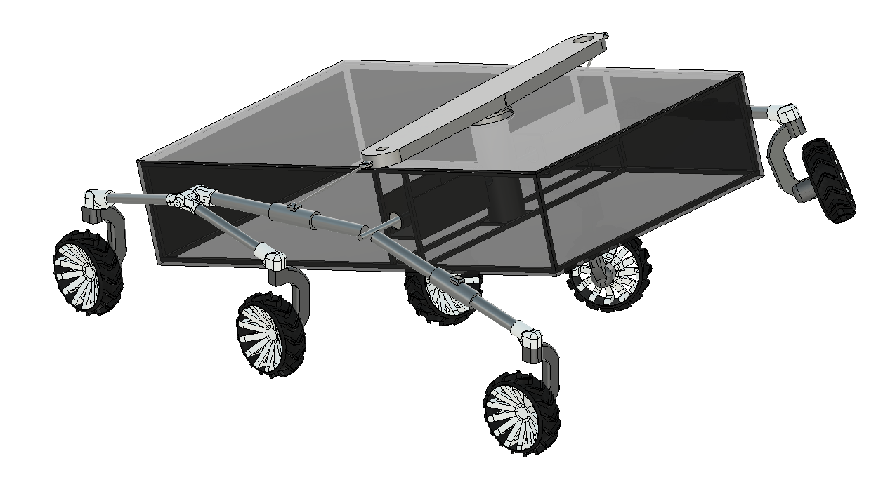
What I'm building & why
The idea
I'm building a low-cost 6-wheel rover that drives itself over rough ground - dirt, gravel, grass - grabs soil and plant samples on its own, and runs actual biology and geology tests onboard. Basically a tiny Mars rover, except I'm doing it with a 3D printer, cheap motors, and a Raspberry Pi instead of a NASA budget. This notebook is my movement/suspension system: how I got from "I want a rover" to an actual Fusion model.
What it needs to do
- drive itself - SLAM mapping + AR marker detection - survive rough terrain - passive rocker-bogie keeps all 6 wheels down - collect samples - 3-DOF arm with a scoop + sealed container - run field biology - Biuret protein test + pigment detection with an RGB sensor - read soil moisture - capacitive sensor - fall back to teleop - live camera over local WiFi
Why rocker-bogie
I went with rocker-bogie because it's what the real Mars rovers use (Sojourner, Curiosity, Perseverance). It's fully passive - no springs, no shocks - and the geometry alone keeps at least 4 wheels on the ground no matter how rough it gets. For a rover carrying a delicate onboard lab across unpredictable ground, that's exactly what I want.
Project: ROVER "Target Fidelity"
Name: SEBDev
Date: 06/30/2026
Page 3

Slide 4
The targets I set
Before touching any math I pinned down what the rover actually had to hit:
ID | What | Target
R-01 | Chassis width | 600 mm
R-02 | Chassis length | 900 m
R-03 | Speed | 150 mm/s
R-04 | Obstacle it can climb | 300 mm (1.5 x wheel D)
R-05 | Driven wheels | 6 (3 per side)
R-06 | Suspension | passive rocker-bogie
R-07 | Steering | servos on the 4 corner wheels
R-08 | Terrain | dirt, gravel, grass
R-09 | Working mass | ~30 kg
The mass kept climbing I started guessing ~22 kg, then bumped it to 30 kg to be safe once I counted the aluminum frame, the onboard lab, and the sampling arm. That 30 kg is what drove my motor and battery choices later (page 13).
Wheelbase != chassis length Big realization: I stopped tying the wheelbase to the chassis length. Keeping them independent is what let me shrink the body to 900 mm while keeping a 1000 mm wheelbase - so the wheels wrap the body.
Project: ROVER "Target Fidelity"
Name: SEBDev
Date: 06/30/2026
Page 4

Slide 5
Digging into rocker-bogie
What I read
I didn't want to wing the suspension, so I dug in. Verma et al. (2017) gave me the sizing formulas. Singh & Jain (2020) covered how the load spreads and how the thing climbs. And I went through NASA JPL's Open Source Rover docs to see how they actually build the differential and joints.
What stuck with me
6-wheel 3-3 layout keeps >=4 wheels grounded at all times. It's fully passive - the geometry does everything, no springs. Bogie pivot position sets how load splits: Case 1 (offset) = 0.21/0.39/0.40, Case 2 (centered) = 0.30/0.30/0.40.
What I chose
I went Case 2 (centered bogie pivot). Splitting the load evenly between the front and middle wheels means less chance one spins out on loose dirt. Either way the rear wheel carries 40%, which told me the rocker arm is the part I'd need to stress-test hardest.
The formulas I pulled from Verma V = pi*D*N/60 (wheel speed) . L = reach/cos(theta) (arm length) . h = reach*tan(theta) (arm height). They used 45deg for climbing stairs; I used gentler 10-15deg since I'm on open ground. Their rule that the differential bar = chassis width is where my axle span came from.
Project: ROVER "Target Fidelity"
Name: SEBDev
Date: 06/30/2026
Page 5

Slide 6
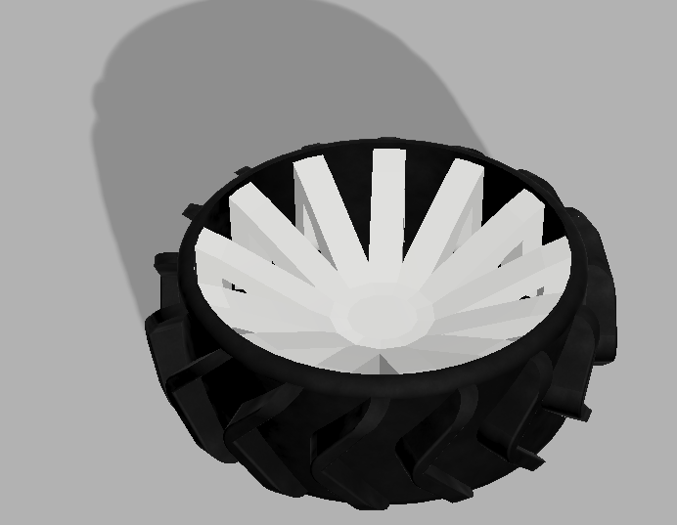
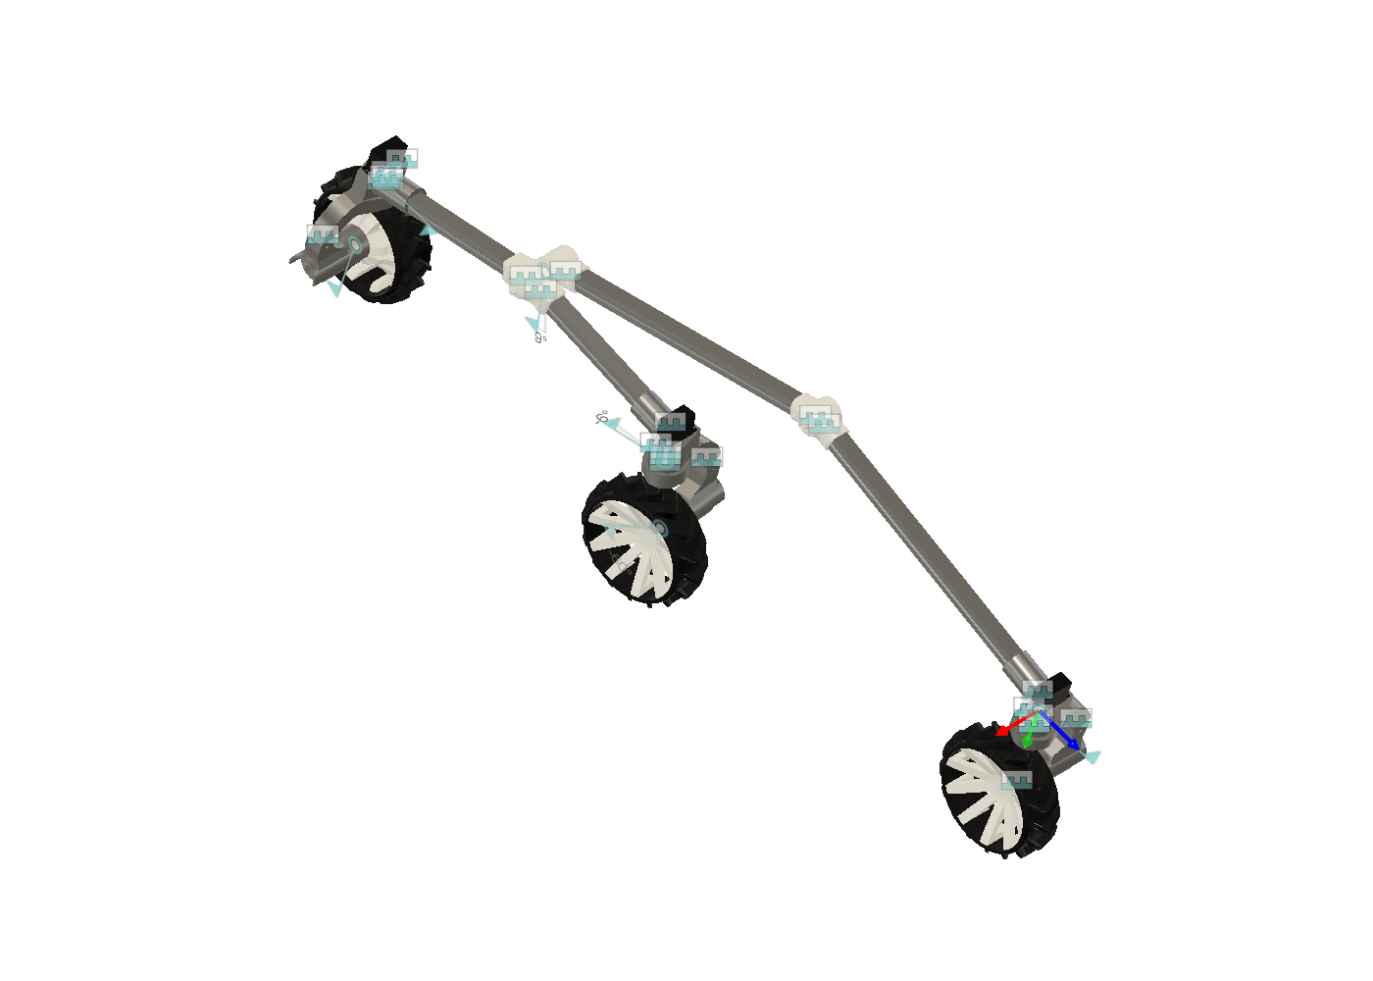
Running the geometry
Wheel speed
N = 60*V / (pi*D) = 60 x 150 / (pi x 200) = 14.32 rpm
So I need ~14.3 rpm at the wheel. Easy for the JGB37 motors - I just regulate down with PWM.
Where the wheels sit
Point | X (mm) | Note
Front W1 | 0 | reference
Middle W2 | 430 | same load as front
Rear W3 | 1000 | end of wheelbase
Bogie pivot | 215 | centered W1-W2
Chassis pivot | 615 | rocker meets chassis
Arms & angles
Bogie (theta=15deg): L = 215/cos15 = 223 mm, h = 57.6 mm -> Joint B at 150deg Rocker (theta=10deg): Seg-A 401, Seg-B 396 (~800 total) -> Joint A at 160deg
Cut lengths aren't the same as center-to-center The lengths above are geometry. When I actually cut tube I subtract what slides into each printed joint: Seg-A 345, Seg-B 366, bogie 202 (Joint A eats 26, chassis fitting 30, Joint B 21).
Project: ROVER "Target Fidelity"
Name: SEBDev
Date: 06/30/2026
Page 6

Slide 7
Loads & how high it can climb
Loads at 30 kg
W = m*g = 30 x 9.81 = 294.3 N R3 (rear) = 0.40*W = 117.7 N <- the heavy one R1 = R2 = 0.30*W = 88.3 N
With a x2 dynamic factor for terrain shocks, the rocker sees ~235 N and the bogie ~177 N. Those are the numbers I'll feed the FEA (page 14).
How high it climbs
My target is 300 mm = 1.5 x wheel D. The theoretical max for rocker-bogie is 2 x D = 400 mm. So I'm at 75% of the ceiling - a comfy 1.33 margin. I'll take it.
Ground clearance
Base clearance is h_bogie + R ~ 158 mm. But my wheel mounts drop the wheels 90 mm, which lifts the chassis, so real clearance ends up ~248 mm. More clearance for obstacles, slightly higher CG - fine for terrain without crazy side slopes.
A note to myself on the load split The 0.30/0.30/0.40 numbers sum to 1.0 over a 3-wheel train. For the FEA I'm treating them as a worst-case load dumped on one wheel, not an average - better to over-build than find out the hard way.
Project: ROVER "Target Fidelity"
Name: SEBDev
Date: 06/30/2026
Page 7

Slide 8
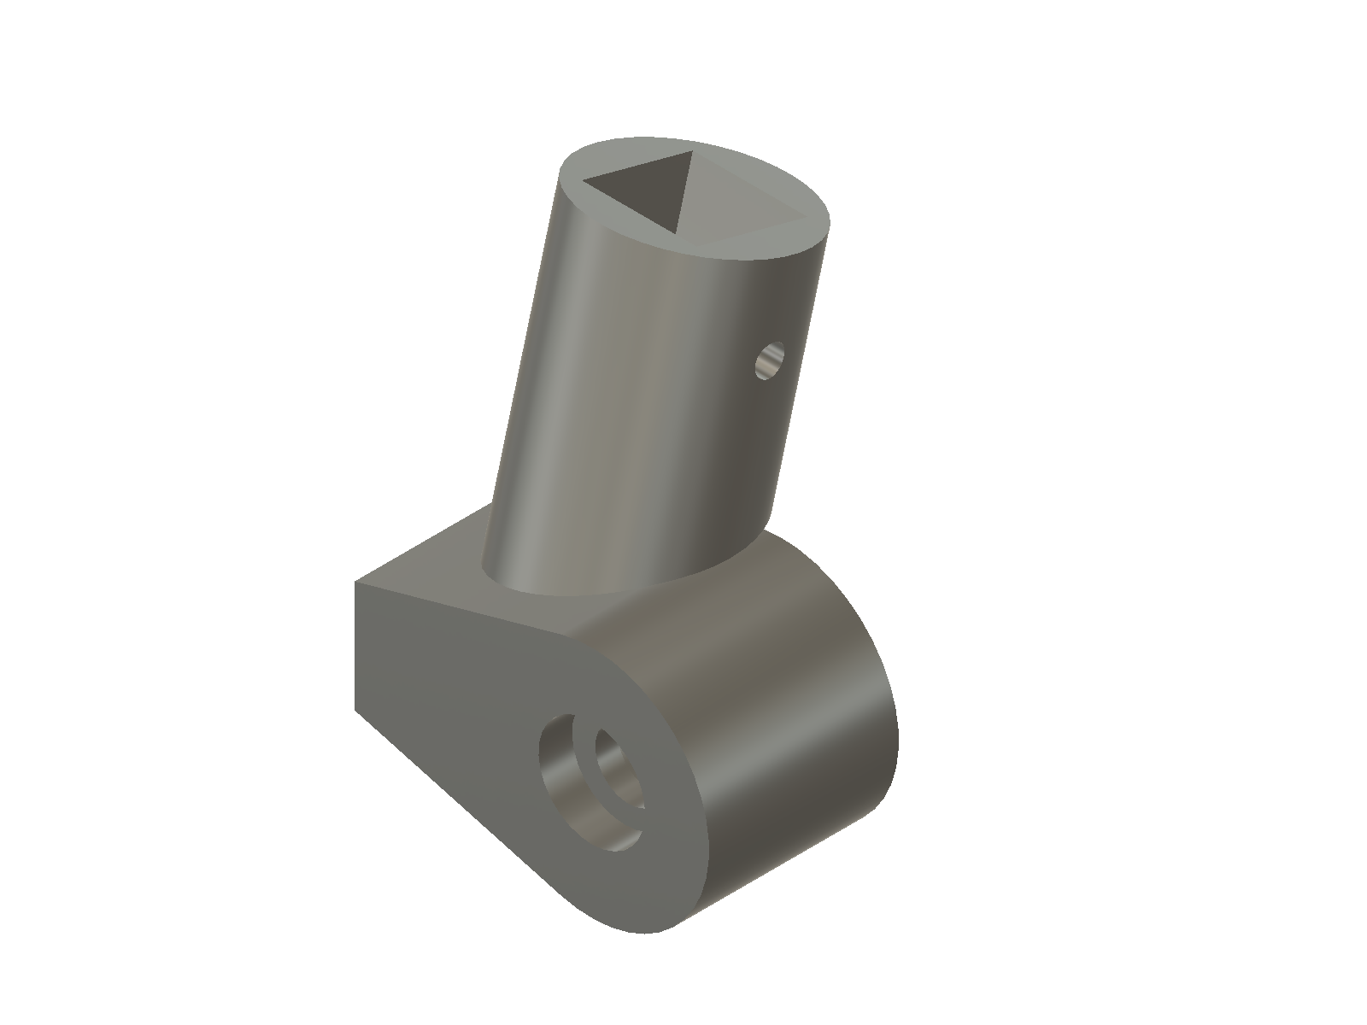
Going round tube + printed joints
The switch
I moved the arms from square tube to round aluminum tube, and made every intersection a 3D-printed PETG joint instead of bending tube or bolting plates. Round tube is easier to source and easier to bond into the joints.
Tube | Profile | Cut length | Qty
Rocker Seg-A | D25 x 2 mm | 345 mm | 2
Rocker Seg-B | D25 x 2 mm | 366 mm | 2
Bogie arm | D20 x 2 mm | 202 mm | 4
Joint | Sockets | Angle | Wall
A (rocker) | 2 | 160deg | 5 mm
B (bogie) | 2 | 150deg | 5 mm
Why I like this The joints hold the angles, so I cut every tube dead straight at 90deg - no mitering, no bending jigs. I print them PETG, 5 perimeters, 60% infill, socket-up, no supports. Tubes press-fit and pin with 2x M5 each.
Bushing, not bearing The D12 axle rides through the boss on a printed plain bushing (greased), not a ball bearing - cheaper and fine for a passive axle. I keep the wall at 5 mm; any thinner and the M5 bolts rip out of the PETG.
Project: ROVER "Target Fidelity"
Name: SEBDev
Date: 06/30/2026
Page 8

Slide 9
The differential mess
Where I went wrong
My first "differential" was just a rigid bar. Reading the JPL docs again, it hit me - that's not actually a differential. A rigid bar doesn't level the chassis; each side just does its own thing. A real one connects both rockers so when one climbs, the other drops and the body stays level. I'd been missing the whole point of the mechanism.
How NASA does it
A central hub that rocks, two turnbuckles (threaded rods with ball-joint ends), and links to each rocker. Chain: rocker -> turnbuckle -> rocking hub -> turnbuckle -> other rocker. The Hackaday writeup literally calls this the crucial link that most DIY rovers skip because it's fiddly - and they lose capability for skipping it.
The thing I finally understood
There are two separate things: the transverse D12 axle (just the pivot the rockers turn on) and the balancin + bieletas on top (the mechanism that actually levels the chassis). My earlier design only had the axle. I'd left out the leveling entirely.
Decision - build the real one For a competition rover where rough terrain is the whole point, real leveling is worth the extra parts. I went with a printed version of NASA's mechanism: a balancin that rocks, two bieletas down to clamps on the rockers. Got it moving right in the Fusion Motion Study.
Project: ROVER "Target Fidelity"
Name: SEBDev
Date: 06/30/2026
Page 9

Slide 10
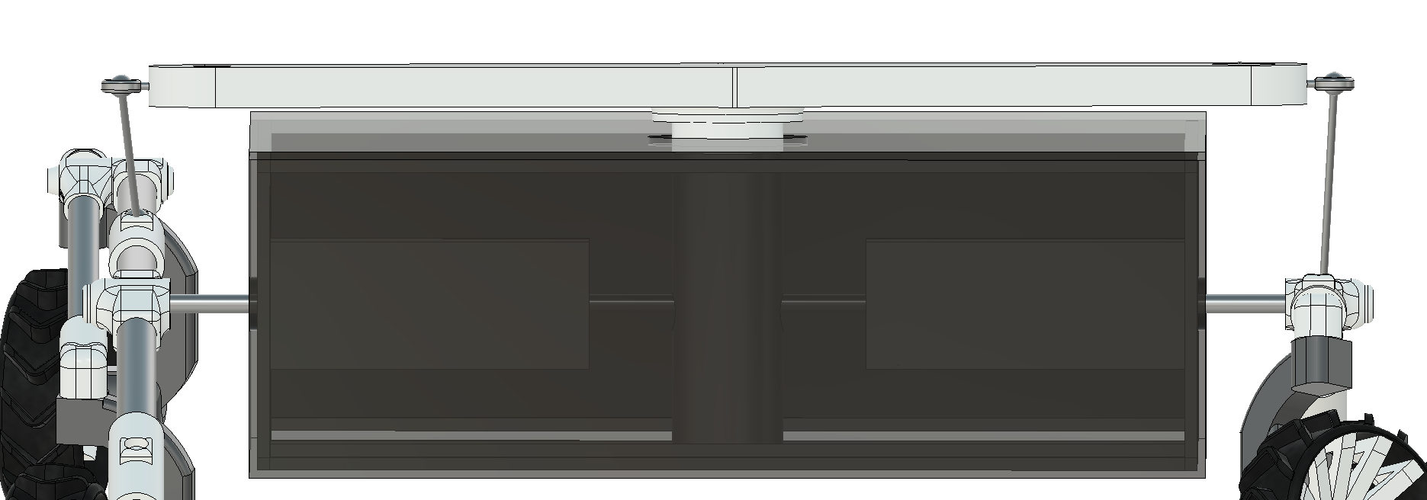
Nailing the differential geometry
Element | What I settled on
Balancin length | 360 mm total
Balancin arm (center -> bielle hole) | 180 mm each side
Balancin pivot | D8 (M8), longitudinal axis
Clamp on rocker tube | one per rocker (2 total)
Clamp offset from rocker axis | 180 mm (= balancin arm)
Clamp position from tube start | 170 mm along the tube
Bieleta length | ~253 mm center-to-center
Bieleta ends | ball joints on BOTH ends
Ratio | 1:1
The 1:1 rule I learned
Balancin arm (180) has to equal the clamp offset (180). If they're not equal, one side moves more than the other and the leveling goes lopsided. The bieleta length doesn't touch the ratio - it just spans the gap. Took me a couple wrong guesses (I had it at 350 once) to get this.
Ball joints on both ends The balancin rocks in one plane, the rocker turns in another. Rigid ends bind it. Rod-end (Heim) joints on both ends of each bieleta soak up the angle - 4 rod-ends total.
Mounted on top The whole differential sits on top of the lid, outside the sealed body - only the D12 axle enters the box. That fixed the bieletas clipping the chassis edge; they now run outside the box.
Project: ROVER "Target Fidelity"
Name: SEBDev
Date: 06/30/2026
Page 10

Slide 11
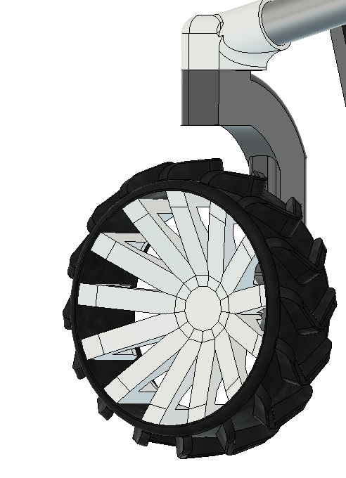
Steering & getting the wheels level
All the same mount
I ended up using the same C-mount body for all 6 wheels. The only difference is the servo: the 4 corner wheels get an MG996R on top for steering (vertical axis), and the 2 middle wheels use the same mount with no servo - fixed.
Socket angles to keep wheels vertical
Mount | Tube | Tilt | Rotate
Front (steered) | Bogie | 15deg | -15 -> 75
Middle (fixed) | Bogie | 15deg | -15 -> 75
Rear (steered) | Rocker B | 10deg | -10 -> 80
Getting them level
All three mounts on a side share the same 90 mm drop (socket -> wheel center). Same H on all three = wheels come out level on their own. 90 mm gives room for the servo above the corner wheels, and the middle mount just copies it even though it has no servo.
Shop trick Instead of measuring angles off the tube, I just orient each socket so the mount hangs plumb (checked with a level) when the rover sits flat. Then the servo axis is vertical automatically. I'll design the mounts with slotted holes so final leveling is a slide-and-tighten on a flat surface.
Project: ROVER "Target Fidelity"
Name: SEBDev
Date: 06/30/2026
Page 11

Slide 12
Shrinking the chassis to 900x600
What I wanted
I wanted the body to tuck inside the wheels, like Curiosity, instead of the wheels sitting inside the body. The realization: this needs wheelbase > chassis length. Moving the pivot alone can't do it - the pivot just slides the body forward/back, it can't change which one is bigger.
Two ways to do it
 | Grow wheelbase | Shrink chassis
I change | the suspension | only the chassis
Wheelbase | 1400 mm | 1000 (same)
Chassis | 1200 mm | 900 mm
Rover size | bigger ~1500 | compact ~1100
Recalc arms? | yes | no
What I picked
Since 1200 mm turned out not to be a hard requirement, I shrank the chassis to 900 mm - it's the simpler move and doesn't touch the suspension. Now wheelbase (1000) > chassis (900), so the wheels wrap the body by 50 mm each end. The differential pivot lands ~108 mm behind chassis center, which loads the rear a bit (helps climbing).
What survived the change All the arm lengths, angles, joints, loads, and the axle span are tied to the wheelbase (unchanged), so they all held. Only the old wheelbase-from-chassis formula broke - now they're independent, which is the whole point.
Project: ROVER "Target Fidelity"
Name: SEBDev
Date: 06/30/2026
Page 12

Slide 13
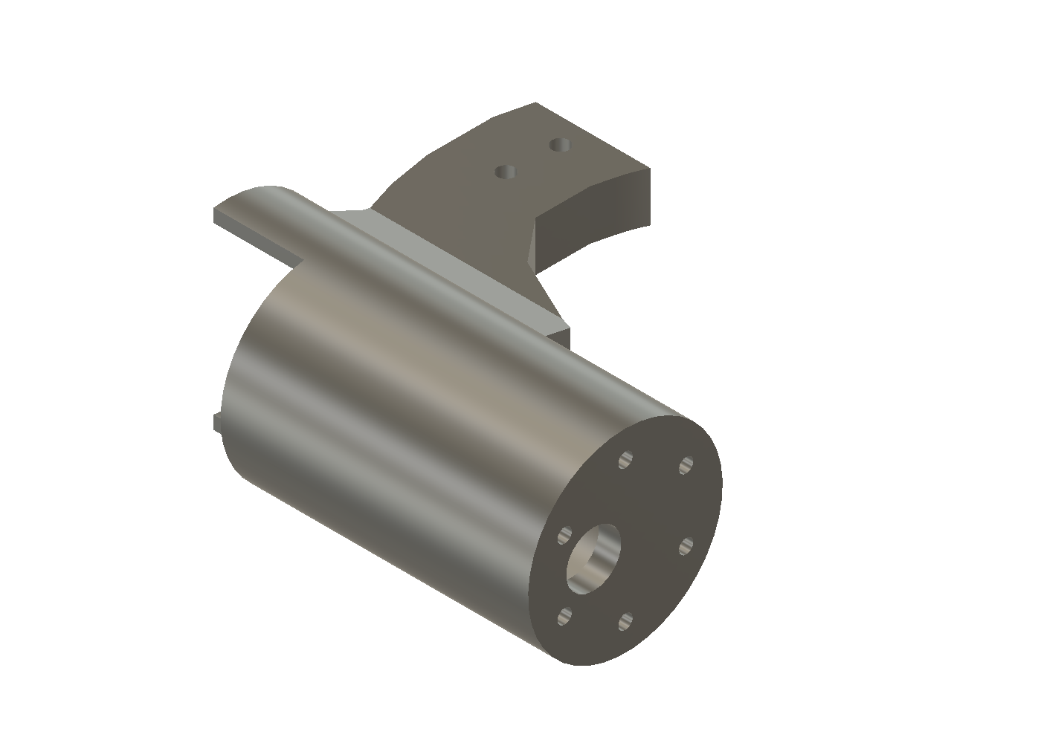
Picking motors & battery
The speed problem
A D200 wheel at 100 rpm is ~1050 mm/s - 7x too fast vs my 150 target. So I need low-rpm, high-torque motors and I regulate down with PWM.
Torque check at 30 kg
~18-25 kg*cm/wheel for a 30deg slope (6 wheels), up to ~50 worst case (3 wheels gripping). I picked the JGB37 50RPM that does 40 kg*cm - good for normal terrain, tight for big obstacles.
What | Choice | Qty | ~COP | Where
Motor | JGB37 12V 50RPM (40 kg*cm) | 6 | $87,600 | I+D
Driver | BTS7960 43A | 2 | $25,000 | I+D
Servo driver | PCA9685 | 1 | $20,000 | I+D/Big
Servo | MG996R | 4 | $26,000 | Bigtronica
Battery | LiPo 8-10 Ah 12V | 1 | varies | -
Battery
At 30 kg I pull ~12.5 A nominal, ~26 A peak when climbing. A LiPo handles those peaks easily and gives ~40 min at 8-10 Ah. I could do 2x SLA 12V 12Ah but they're heavy.
still need to check - encoder The 40 kg*cm listing at I+D doesn't clearly say it has an encoder. For SLAM I need the encoder version (JGB37-520 Hall, 6 wires). I have to confirm at the store or source the encoder variant separately before I buy.
Project: ROVER "Target Fidelity"
Name: SEBDev
Date: 06/30/2026
Page 13

Slide 14
My FEA plan (targets)
I'll run Static Stress in Fusion on the parts that carry the most. These are the numbers the design SHOULD hit - I haven't solved it yet, so I'll swap in the real values once I run it.
Part | Load | Target SF | Peak stress | Deflection | Pass
Rocker (Al) | 235 N | 3-5 | 60-90 MPa | <2 mm | SF>=2.5
Bogie (Al) | 177 N | 4-6 | 40-60 MPa | <1.5 mm | SF>=2.5
Joint A (PETG) | 235 N | 2.5-4 | 15-25 MPa | <1 mm | SF>=2.0
Joint B (PETG) | 177 N | 3-5 | 10-20 MPa | <1 mm | SF>=2.0
Axle D12 (steel) | 118 N/side | 2-3 | 80-140 MPa | <3 mm | SF>=2.0
How I'll read it
Aluminum arms should be comfy (SF 3-5). If the rocker drops under 2.5 I'll step up to D28 tube. PETG joints are the tight ones - I'll mesh finely at the socket roots. The D12 axle is the one I'm watching - a 700 mm rod can flex. If deflection > 3 mm I'll go D15 or add a center support.
Motion study comes first Before FEA I check the kinematics: the two rockers move in opposition, the bogie swings free, nothing collides. 11 revolute joints total. If the ball joints on the differential are set right the linkage transmits with no Motion Link - I already got that working.
Project: ROVER "Target Fidelity"
Name: SEBDev
Date: 06/30/2026
Page 14

Slide 15
Bill of materials
Prices in COP from I+D (Didacticas Electronicas, Medellin) and Bigtronica, early 2026. Ballpark - they drift.
Part | Qty | Note / price
JGB37 12V 50RPM (40 kg*cm) | 6
BTS7960 43A driver | 2
MG996R servo | 4
PCA9685 PWM driver | 1
Al round tube D25x2 | ~1.6 m
Al round tube D20x2 | ~0.9 m
Steel rod D12 x 700 | 1
Aluminum 2020 extrusion | ~3 m
Rod-end ball joints M5 | 4
Rim (PETG) + tire (TPU) | 6 ea
Raspberry Pi 4 + Arduino R4 | 1 ea
Filament + where I'm sourcing ~600 g PETG (joints, mounts, rims, bearing blocks, balancin, clamps) + ~250 g TPU 95A (tires). All suppliers are in Medellin: I+D (Suramericana + CC La Cascada), Bigtronica, El Palacio del Aluminio, Grupo Roldan, Electronilab. Steel rod + pins from any steel depot - I ask for 'barra calibrada D12'.
Project: ROVER "Target Fidelity"
Name: SEBDev
Date: 06/30/2026
Page 15

Slide 16
Redesigning the wheel joint: bearing + real angles
Borrowing from a proven reference
Instead of designing the steering knuckle from scratch, I pulled the geometry from the "Mars Rover Perseverance Replica" build (SolidWorks files, now in the Referencia folder) and reused their Servo coupler, Servo Horn, and Wheel Joint parts as-is. Checked my 37 mm gear motor (6 mm D-shaft, 31 mm bolt circle) against their "Wheel 1 Joint p2" cavity - exact fit, no scaling needed.
A bearing I don't have to buy
The knuckle needed a bearing between the servo coupler and the wheel shaft. Instead of buying one, I generated a print-in-place ball bearing in OpenSCAD (BOSL2 library) sized to the "635" standard - ID5/OD19/W6mm, dumbbell rollers, 0.15mm clearance. Prints straight into the socket, no purchased part.
Getting the angle from the real model, not the docs
The socket has to tilt so the servo's steering axis comes out perfectly vertical even though the rocker/bogie arm it sits on is angled. I stopped trusting my old notes and computed the real angle straight from the live Fusion assembly (walking occurrence.transform2 chains): 30deg at the front/rocker corner, 10deg at the rear/bogie corner.
Mirrored for the other side Once the geometry was right on one side, I mirrored all three knuckle variants (JuntaLlanta, JuntaLlantaEstatica, JuntaLlantaDireccion) across the chassis plane and saved them as their own files (...I suffix) - so the 6-wheel layout is properly symmetric instead of hand-copied angles.
Project: ROVER "Target Fidelity"
Name: SEBDev
Date: 08/09/2026
Page 16

Slide 17
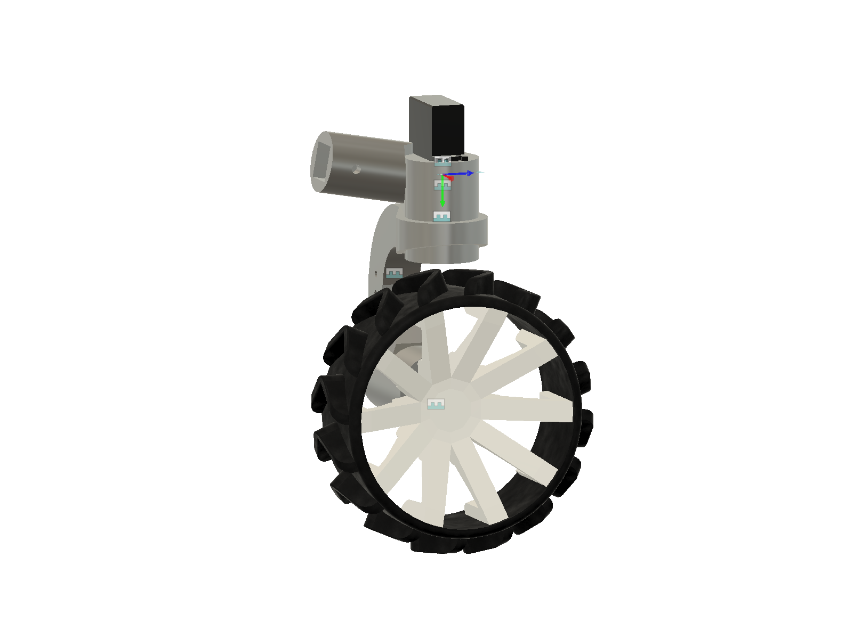
Getting a real quote for the shopping list
What a real quote actually costs
Got a real quote from I+D Didacticas Electronicas (Cotizacion S174842, COP $2,216,852 with IVA) - all 6 JGB37 motors, 3 BTS7960 drivers, the steering servos, 13m of 2020 aluminum profile, PETG/TPU filament, and more, nothing purchased yet. Updated bom_rover.csv line by line against the quote - prices that were rough guesses before are now marked "Cotizado" with the real numbers.
The encoder question, closed
Page 13 left this open: whether I needed the Hall-encoder motor variant for SLAM odometry. Didn't have to chase it down - bought 2x 448 CPR optical encoders sized for the 37mm motor shaft instead, so odometry is solved independent of which JGB37 variant I run.
New brain: one board instead of two
Swapped the planned Raspberry Pi 4 + Arduino R4 pair for a single Arduino UNO Q - 2GB RAM, 16GB eMMC, a Linux-capable Cortex-A53 side plus a realtime Cortex-M33 side on one board. One less board to wire and power, no separate microSD to manage.
Still pending Chassis hardware (round tube, acrylic lid, most of the bolts), the battery + charger, and the lab sensors are not in bom_rover.csv yet - no real quote for them so far. This quote covers movilidad, chasis extrusion, filament, and the brain, but nothing has actually been ordered yet.
Project: ROVER "Target Fidelity"
Name: SEBDev
Date: 08/09/2026
Page 17

Slide 18
Where I'm at & what's next
What's actually built
All three wheel-joint variants (JuntaLlanta, JuntaLlantaEstatica, JuntaLlantaDireccion) have their final socket geometry, sized and angled off the real assembly, plus mirrored left-side copies so the 6-wheel layout is symmetric. The steering knuckle carries a printed bearing instead of a bought one, and I validated the mount against a real MG995 servo in a standalone test assembly first.
What's priced vs. still pending
Movilidad electronics, chassis extrusion, filament, and the brain are priced out in a real quote (bom_rover.csv, Cotizacion S174842) but nothing has been purchased yet. Still needed, no quote yet: round tube + steel axle for the differential, the acrylic/MDF lid, the battery + charger, and the lab module hardware (color sensor, pumps, syringe dispenser).
Next up
Finish the 4 remaining wheel-corner assemblies as real linked-component Fusion assemblies (not flattened single-body hacks), using Ensamble llanta / Ensamble llanta Largo as templates. Then close out the differential/balancin hardware and start on the chassis build.
A trick worth keeping For any live-assembly measurement (angles, positions), read it straight from occurrence.transform2 chains in the actual model instead of trusting old notes - the model changes faster than the docs do.
Project: ROVER "Target Fidelity"
Name: SEBDev
Date: 08/09/2026
Page 18

